Slide 1
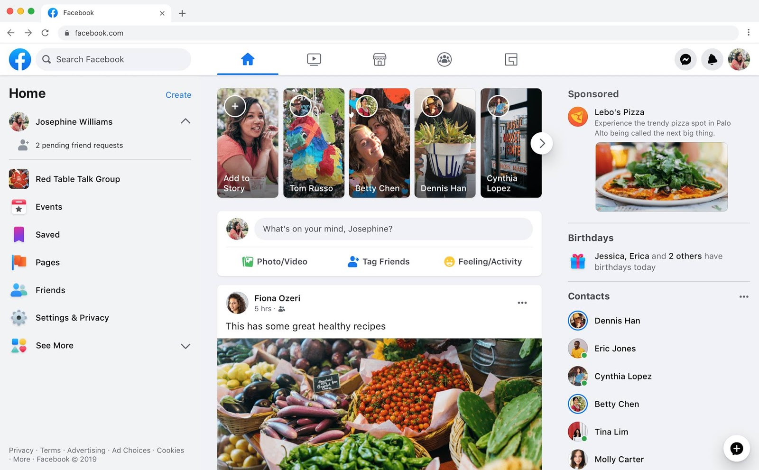
Identify root components of website below

Slide 2
Flex-direction: row;
nav
Flex: 0;
main
Flex: 1;

Slide 3
Manu| Navegation
Flex: direction: row;
Div-left
Div-center
Div-right
flex: 0.5;
flex: 1;
flex: 0.5;

Slide 4
Manu| Navegation
logo
search
logo
logo
logo
logo
logo
icon
icon
image
Flex-direction: row;
Justify-centent: center;
Flex-direction: row;
Justify-centent: space-around;
Flex-direction: row;
Justify-centent: flex-end;

Slide 5
Main
Flex: 0.5;
Flex: 1;
Flex: 0.5;
Left-sidebar
Main-content
Right-sidebar
Flex-direction: row;

Slide 6
Left-sidebar
Home
create
Flex-direction: row
Justify-content: space-between;
image
icon
Flex-direction: row
Justify-content: space-between;
image
Name
icon
Name
icon
Name
Flex-direction: row
icon
Name
icon
Name
icon

Slide 7
Main|content
Flex-direction: column;
story
Flex: 0.2
header
Flex: 0.2
Nav-main
Flex: 0.2
main
Flex: 1

Slide 8
Main|content
image
button
icon
icon
icon
image
icon
photos

Slide 9
Manu | Right sidebar
Header-side
Flex-direction: column;
Flex: 0.2
nav-nav
Flex: 0
Main-side
Flex: 1

Slide 10
Manu | Right sidebar
text
flex-direction: column;
Align-self: center;
image
photos
text
icon
flex-direction: column;
text
icon
image
Name
image
Name
flex-direction: column;
Align-self: center;
image
Name
image
Name
image
Name

